Slide 1
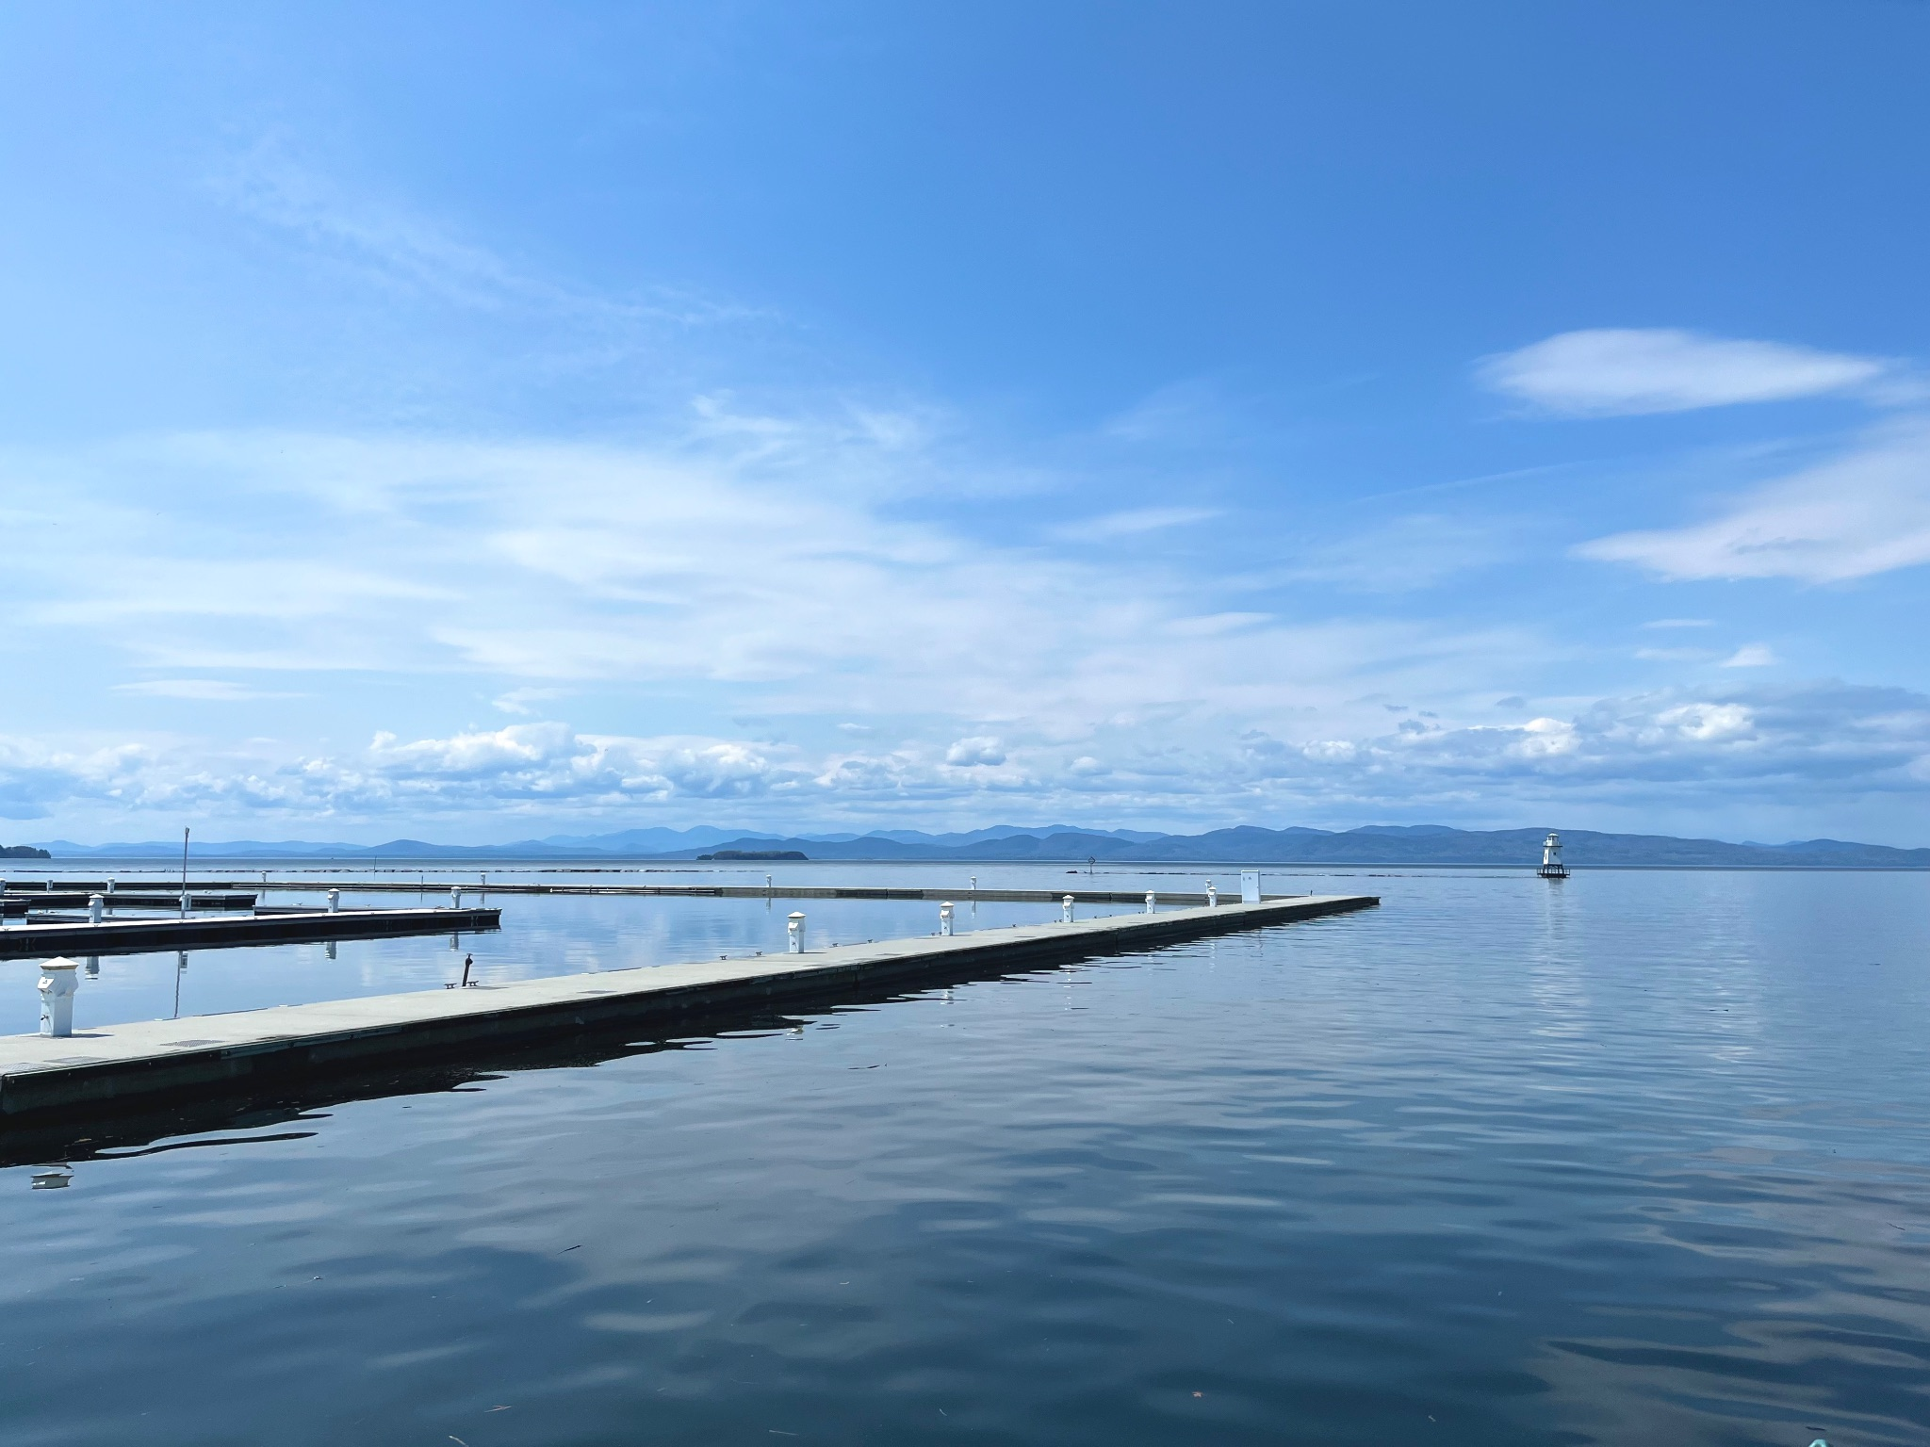
Limited Seasonal Thermal Acclimation in Lake Champlain Calanoid Copepods
Summer Interns: Aly, Chanchal, Jamie

Slide 2
Outline
Main point: Big seasonal changes in temperature in Lake Champlain (>15°C); Small corresponding changes in thermal limits with temperature, but large differences between species; Changes in community composition (tied to temperature)
What results are needed to make this point:
What methods do people need to understand: Tow and CTmax (what is CTmax and how did we measure it); Where is temperature data coming from; Where are copepods coming from (nearshore vs. offshore)
Community composition may differ from what the data shows (differences in difficulty of collection)
What’s the broader context: How will aquatic communities (composition and abundance) change due to climate change (summertime warming; warmer winters) and how will this affect community function (carbon flux and mass/energy transfer to upper trophic levels); Vulnerability strongly affected by acclimation (and adaptation; generation times of these copepods is too long to enable seasonal adaptation)
BUT: Copepod thermal limits (and especially those of freshwater copepods) are largely unknown, especially at the fine temporal scale needed to understand seasonal patterns in ecosystem functioning
Why does this work matter: Acclimation has only limited capacity to reduce vulnerability; species-specific differences in thermal limits affect community vulnerability
What have you taken away from this work:
Other points to make: CTmax-size correlations (d; Fecundity patterns; Predator-prey CTmax patterns; Invasive species
Notes:
formula for presenting figures
- state the axes, color coding, regression
- then talk about patterns
- build on complexity

Slide 3
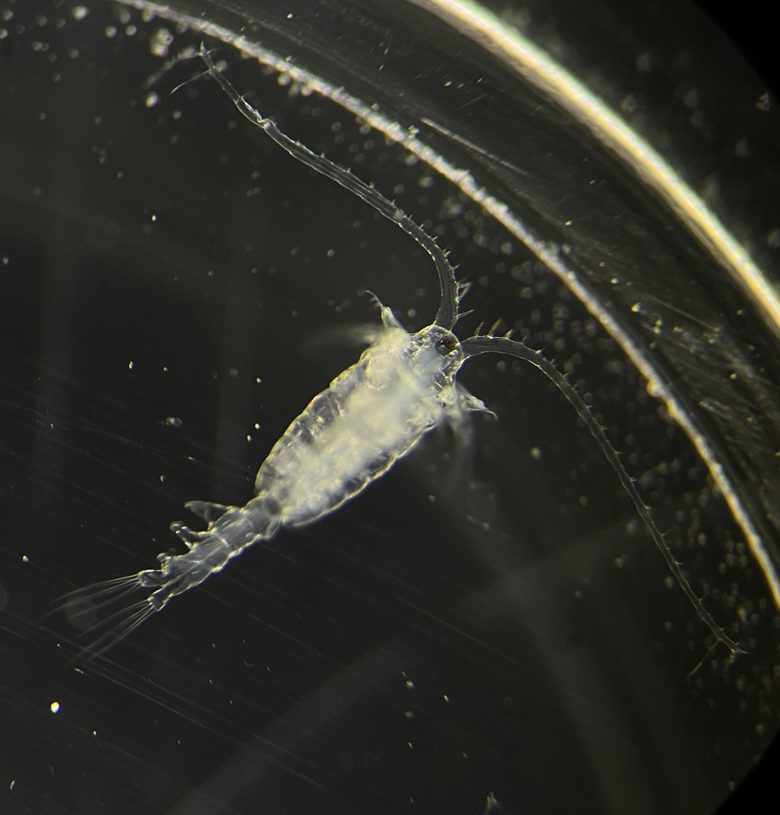
Importance
Copepods are essential in aquatic ecosystems
Transfers mass and energy to upper trophic levels
Facilitates carbon sink
Climate change can put copepods at risk
Factors that harm copepods harm other organisms
Notes:
Consume producers and become food for secondary consumers. Transfer mass and energy. Producers capture atmospheric carbon from CO2 and copepods move it up the trophic levels
Copepods are a large component of aquatic ecosystems and removing them puts the organisms that rely on the at risk
Copepods with a lower thermal tolerance will face more difficulty
To make any predictions or take any action, there must be data

Slide 4
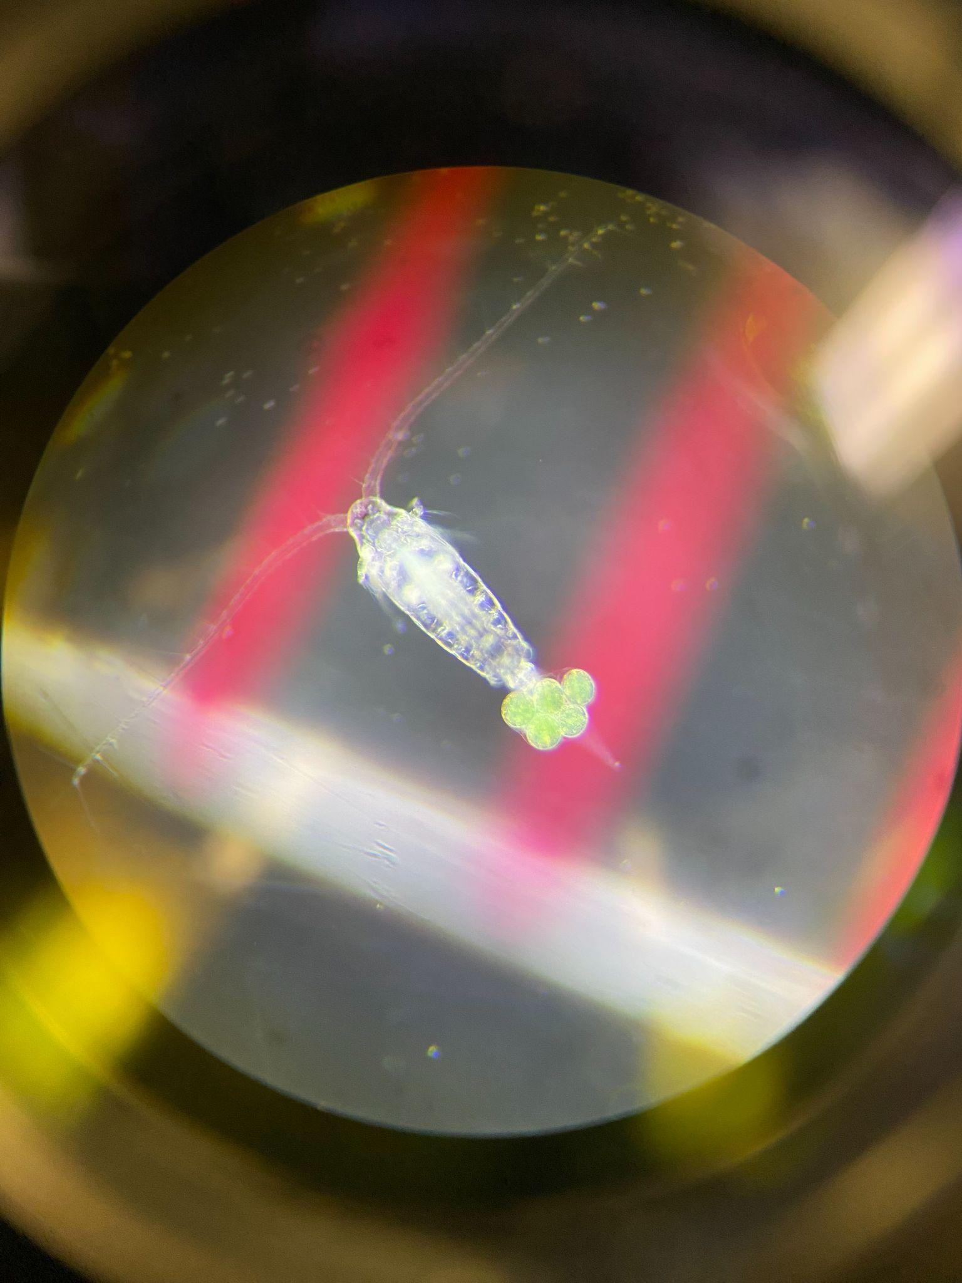
Background
Differences in thermal tolerances amongst species affect community composition
Minimal data for freshwater copepod thermal limits and acclimation capacities
Assessing their vulnerability provides valuable data
Notes:
Type of copepod characterised by long antennules
To observe the effects of climate change on copepods
Can they acclimate and possibly adapt?

Slide 5
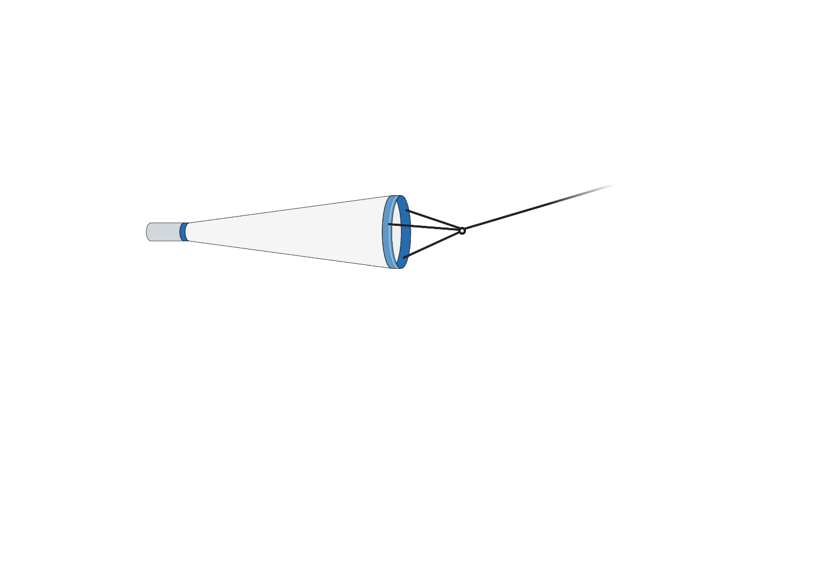
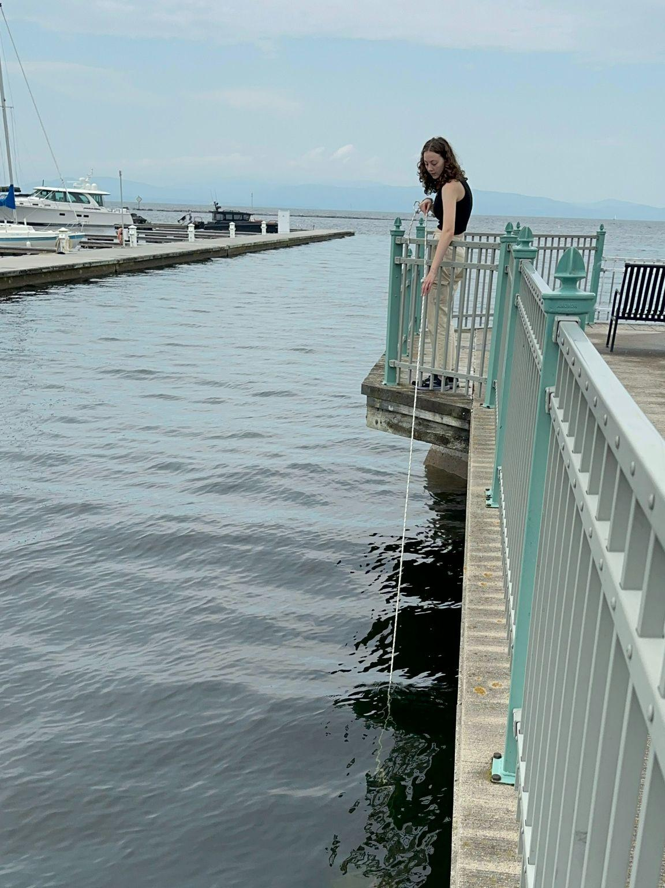
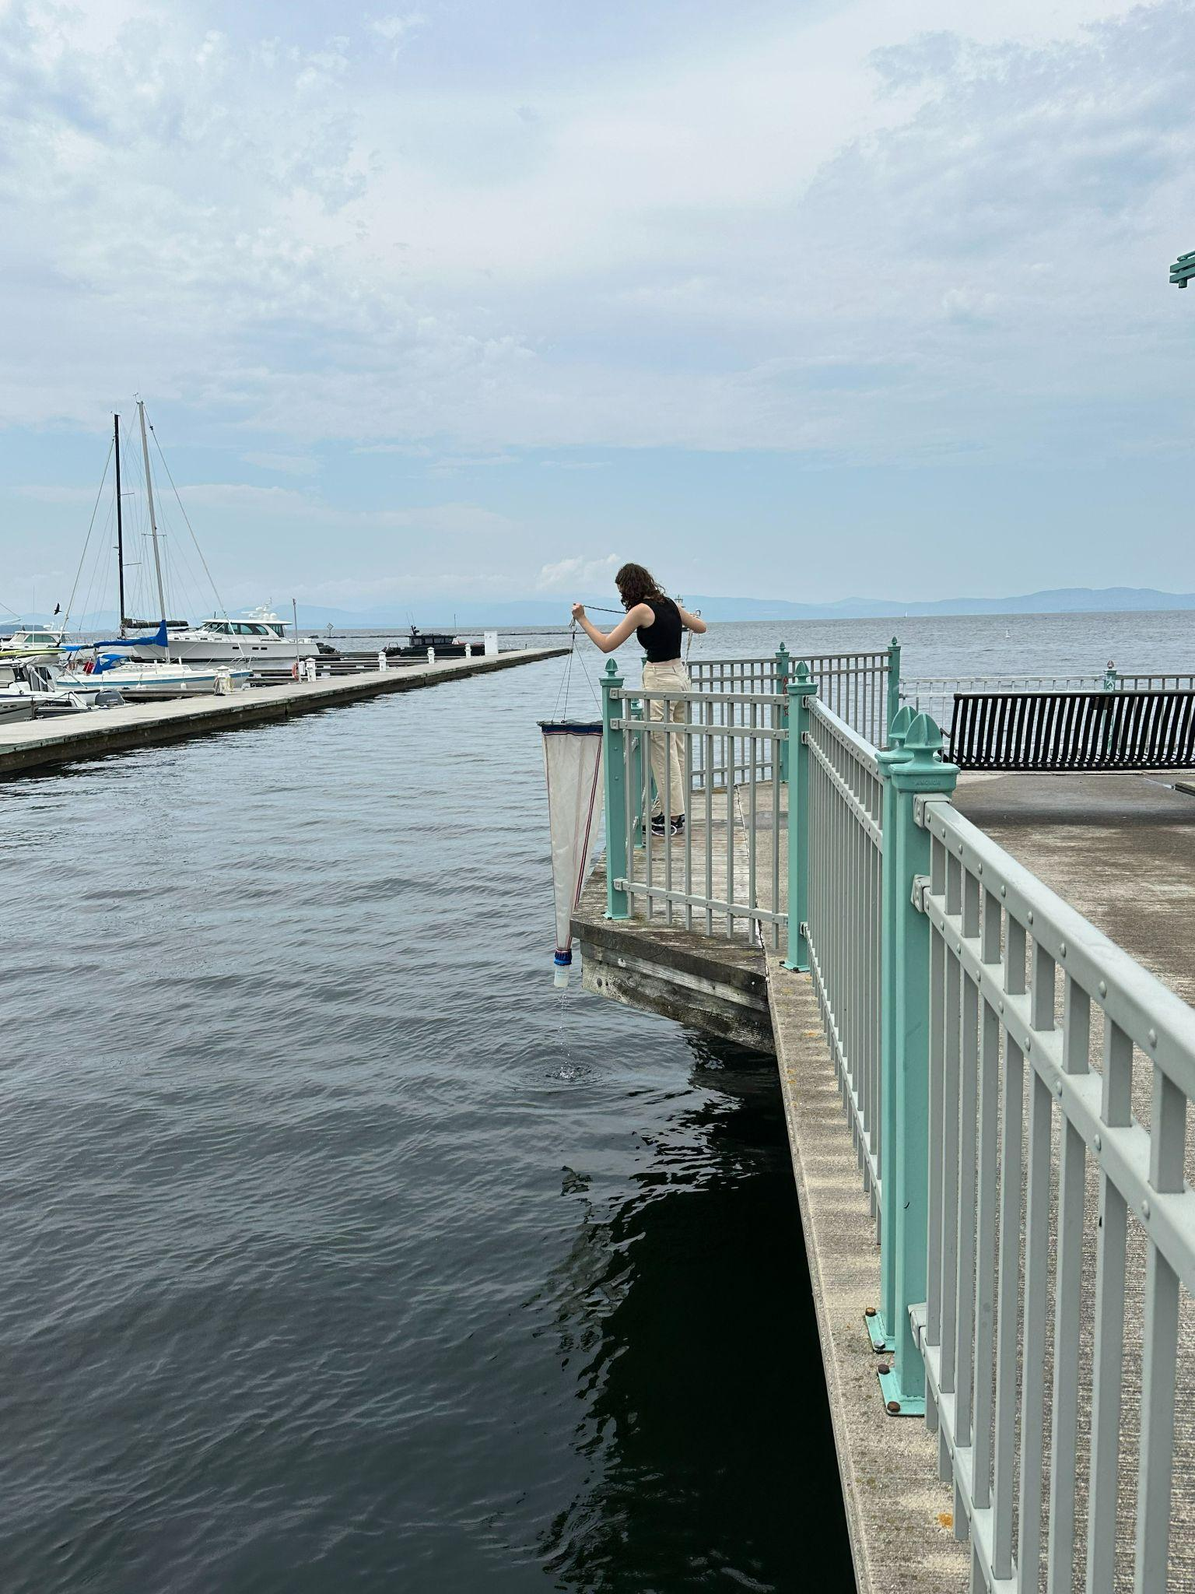
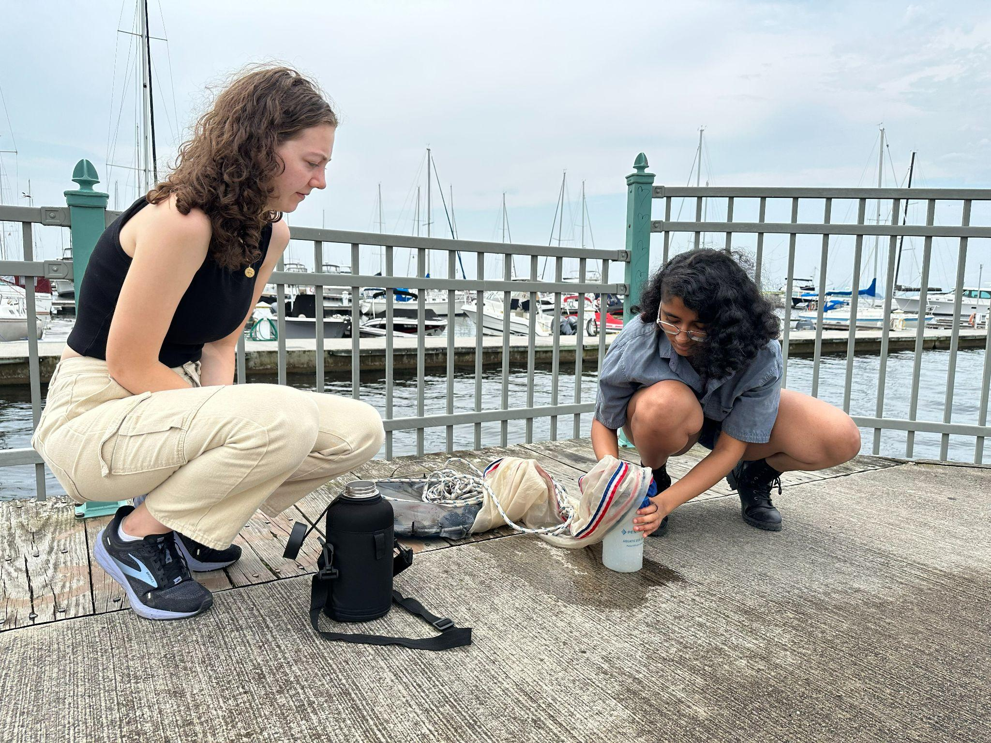
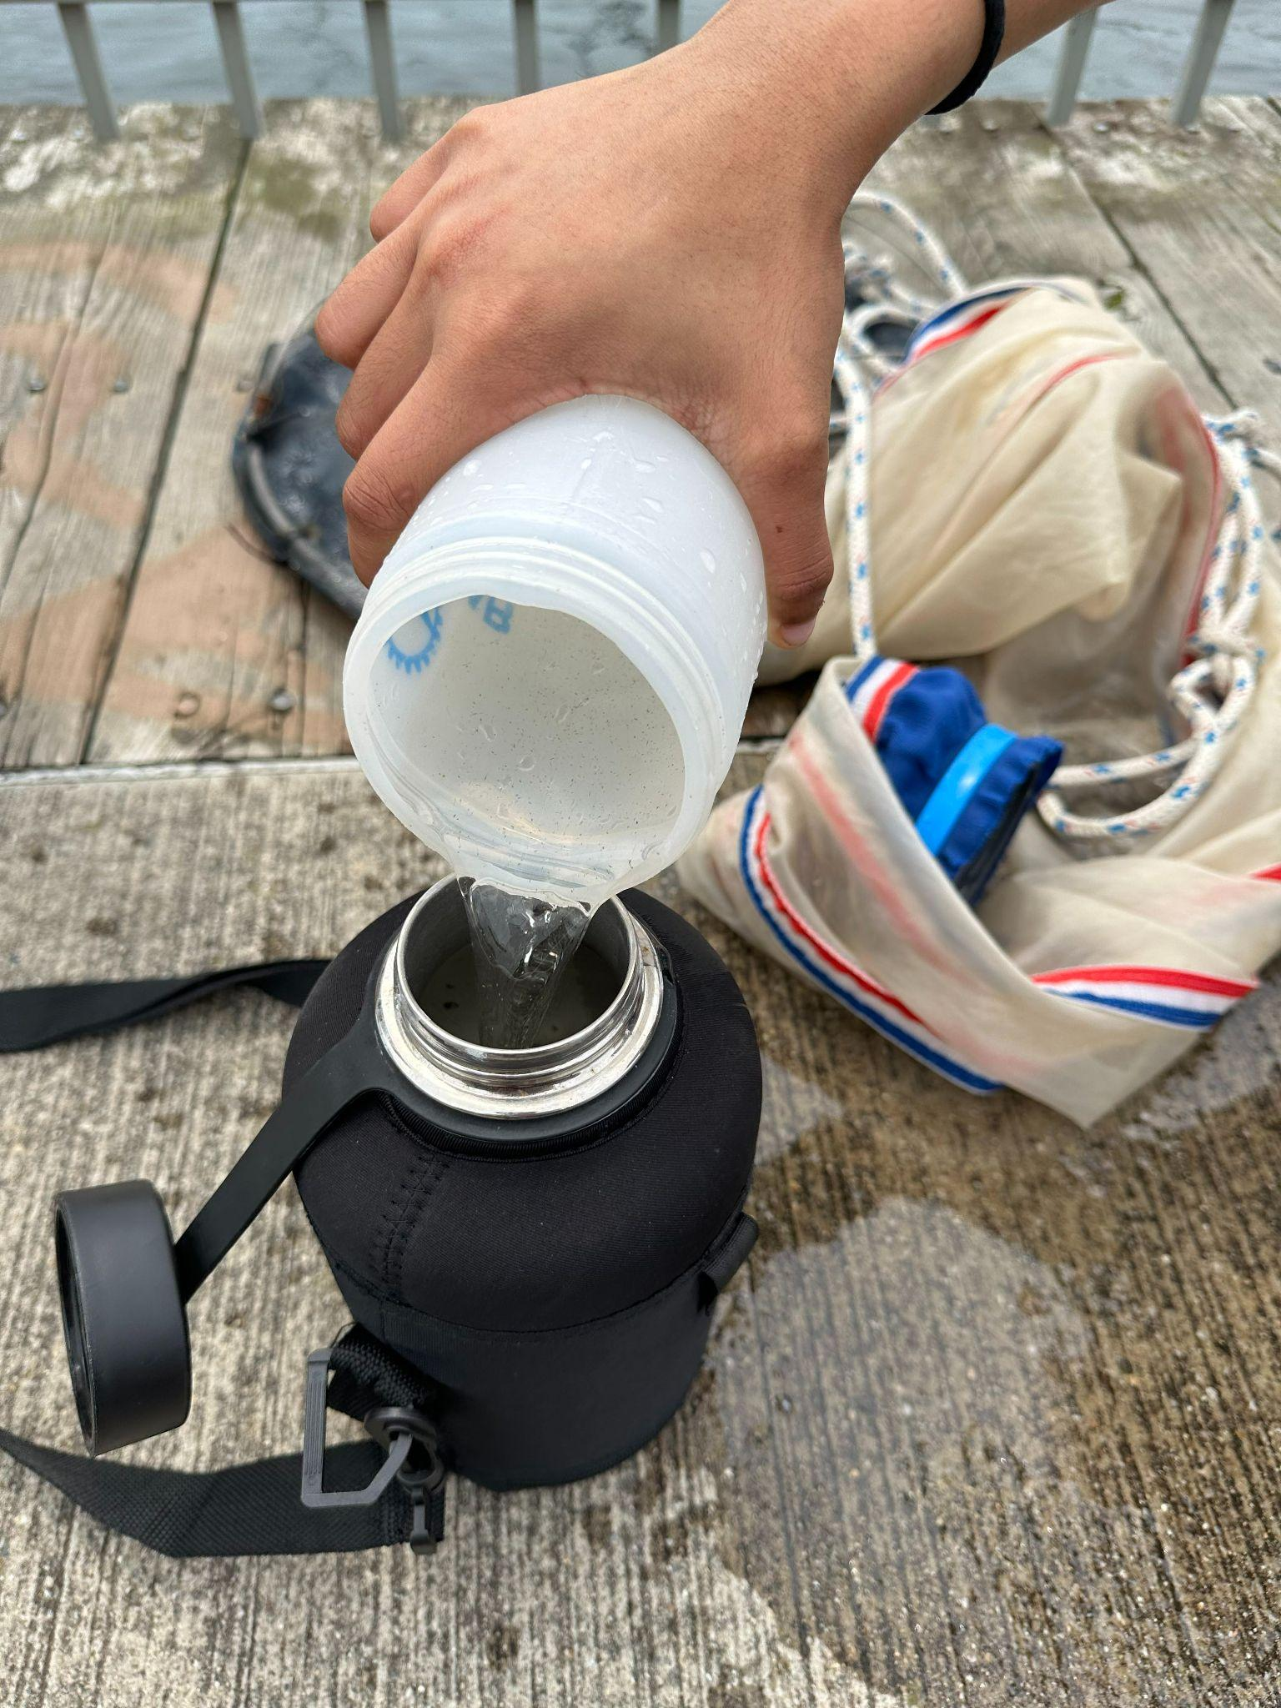
Methods - Plankton Tow
Burlington Fishing Pier
Water temperature taken at site during collection
250 μm net; plankton kept at temperature of collection

Slide 6
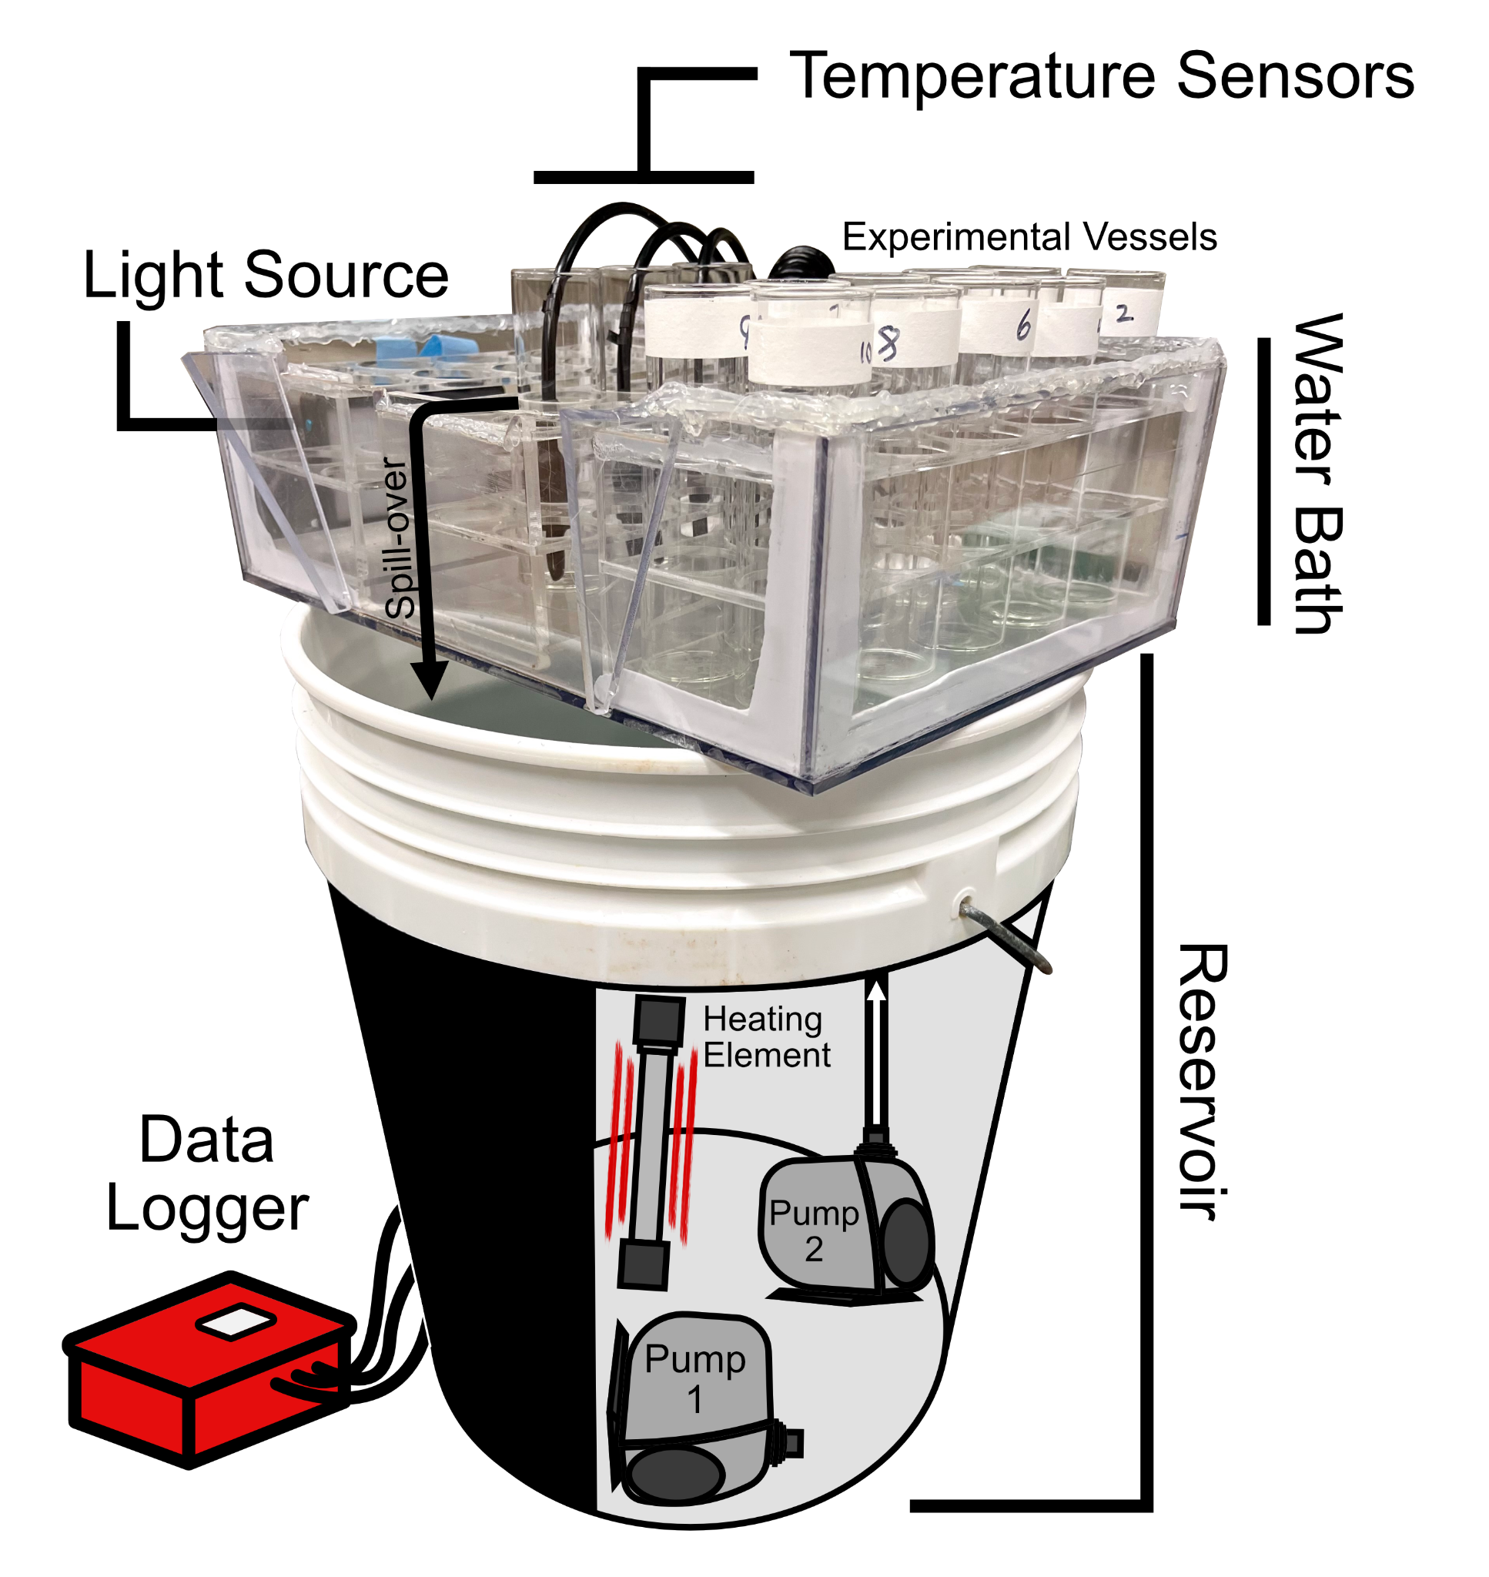
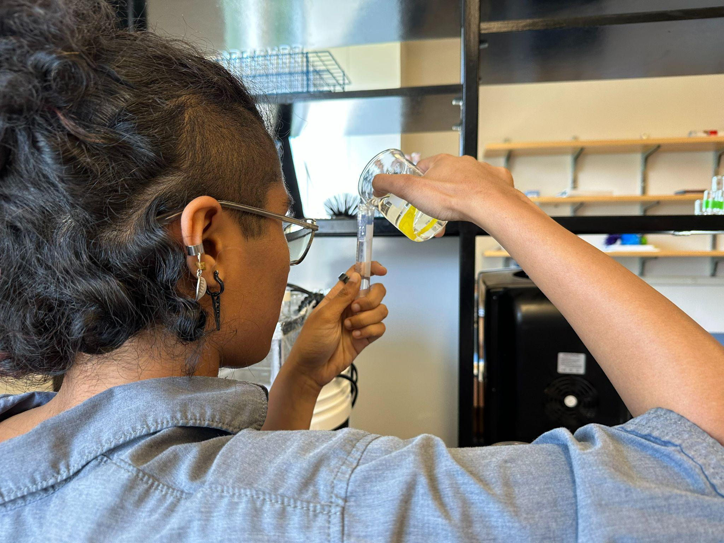
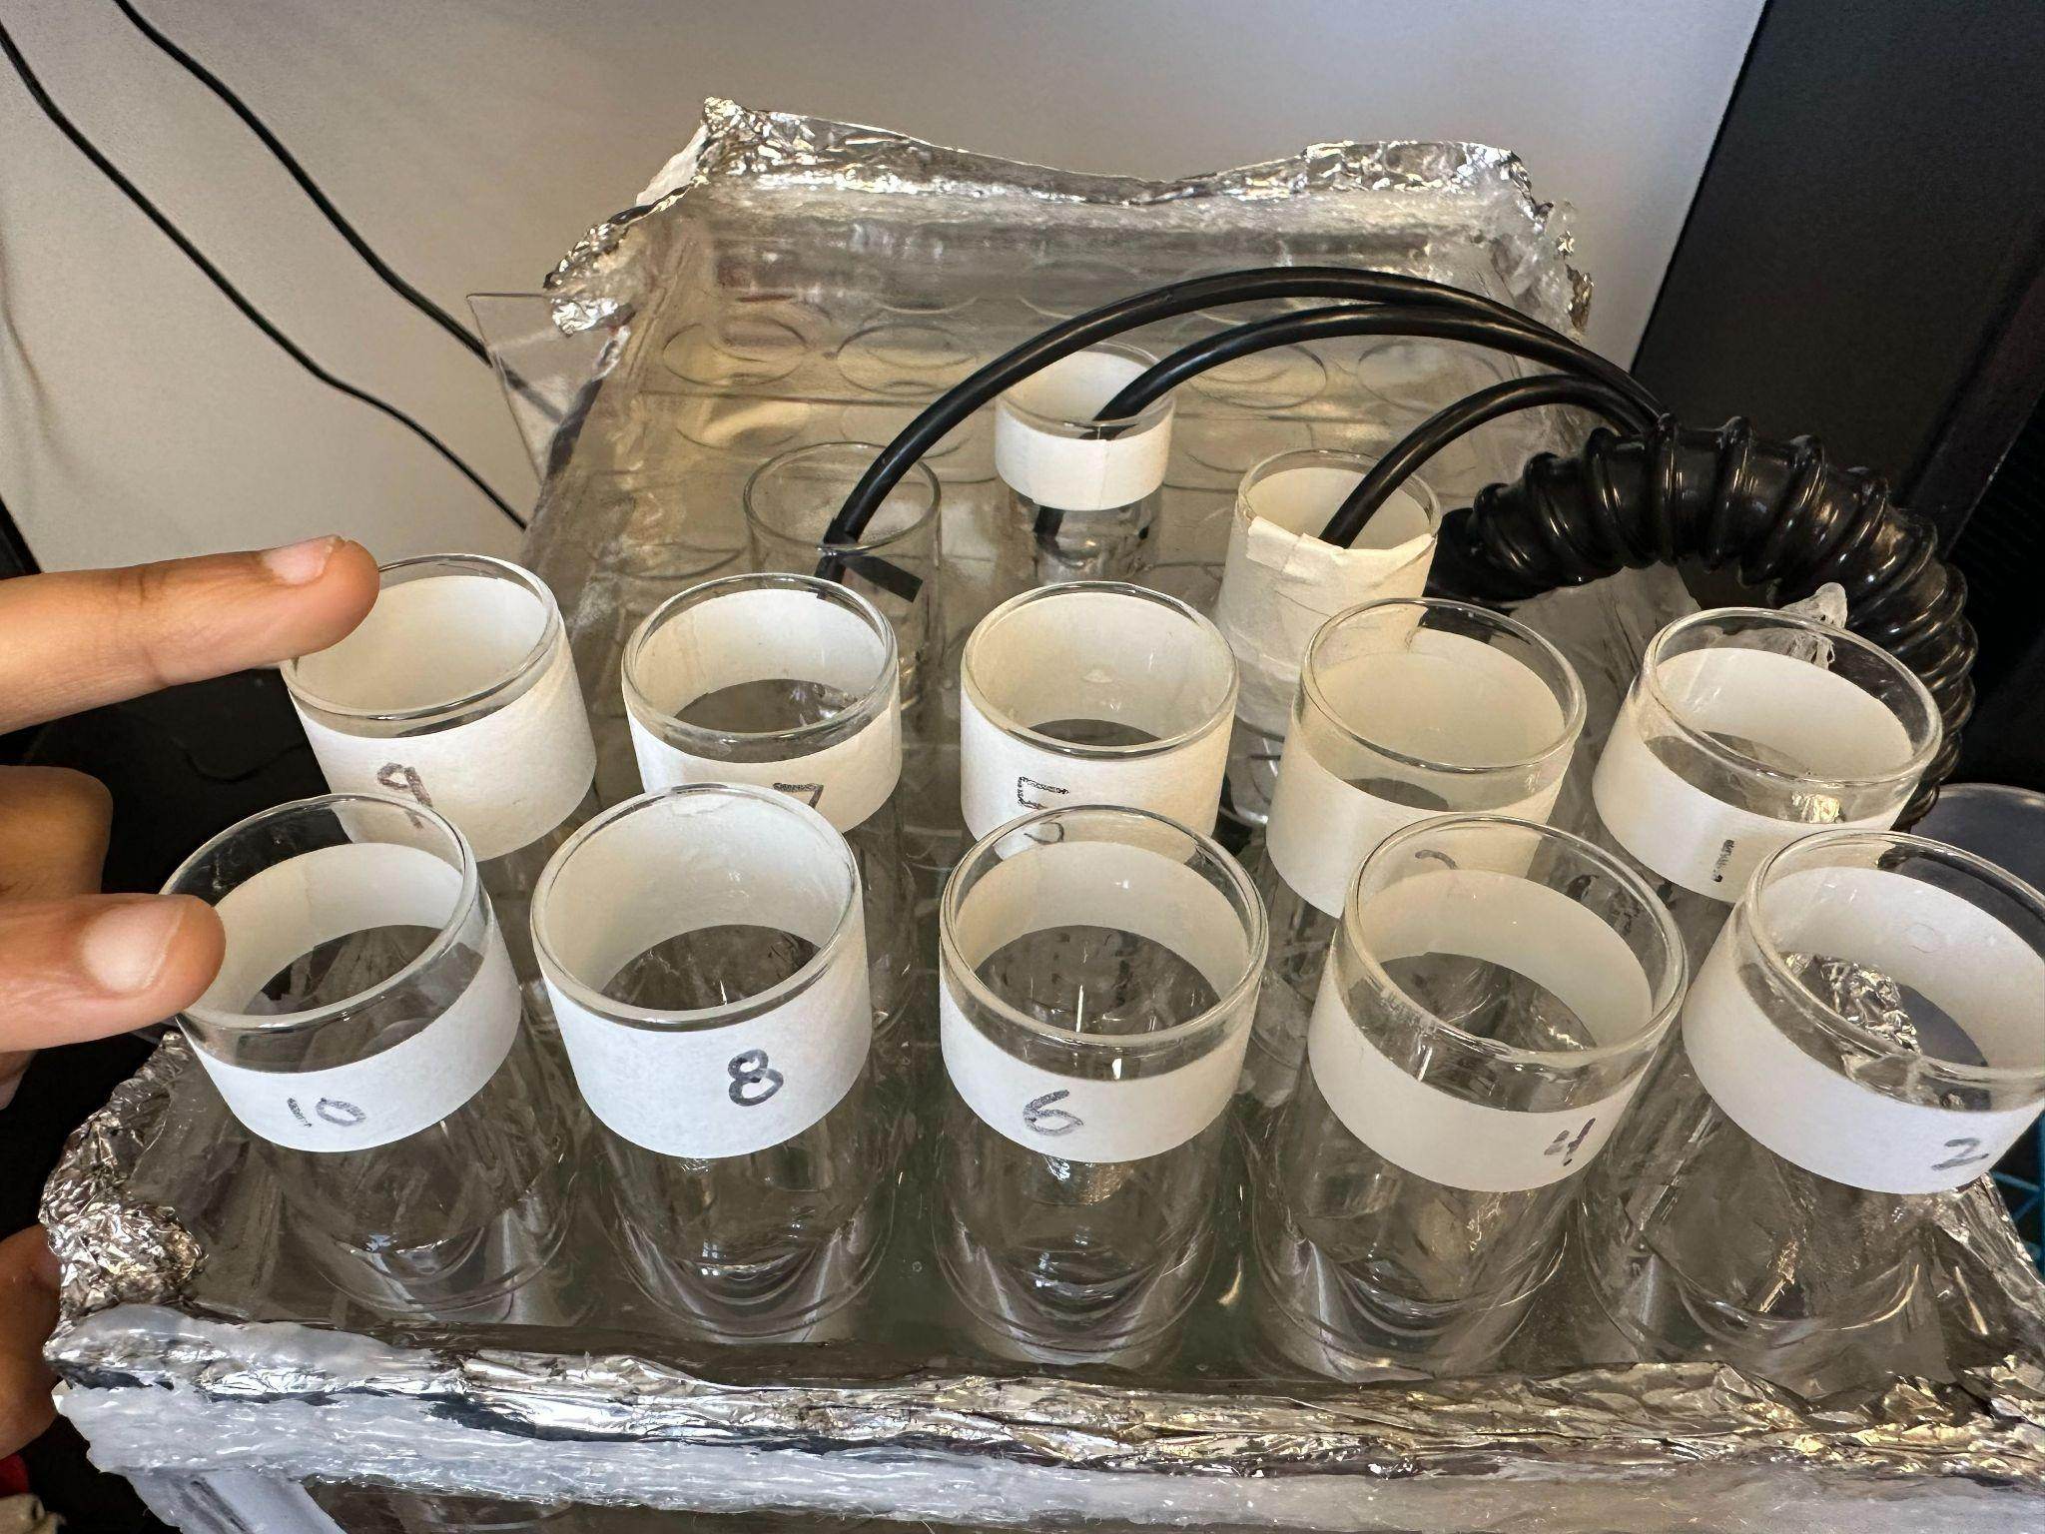
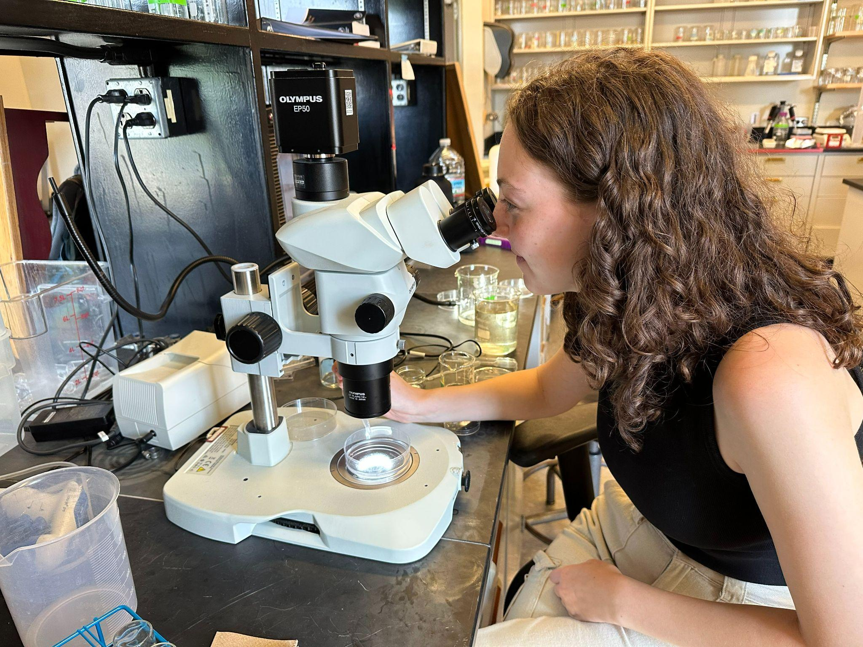
Methods - CT_{max}
Temperature at which the copepods stop responding to the stimulus of water movement
Bottled spring water used based on preliminary test
10 ml and 1 copepod per tube
Temperature ramp of 0.2 ℃ per minute average

Slide 7


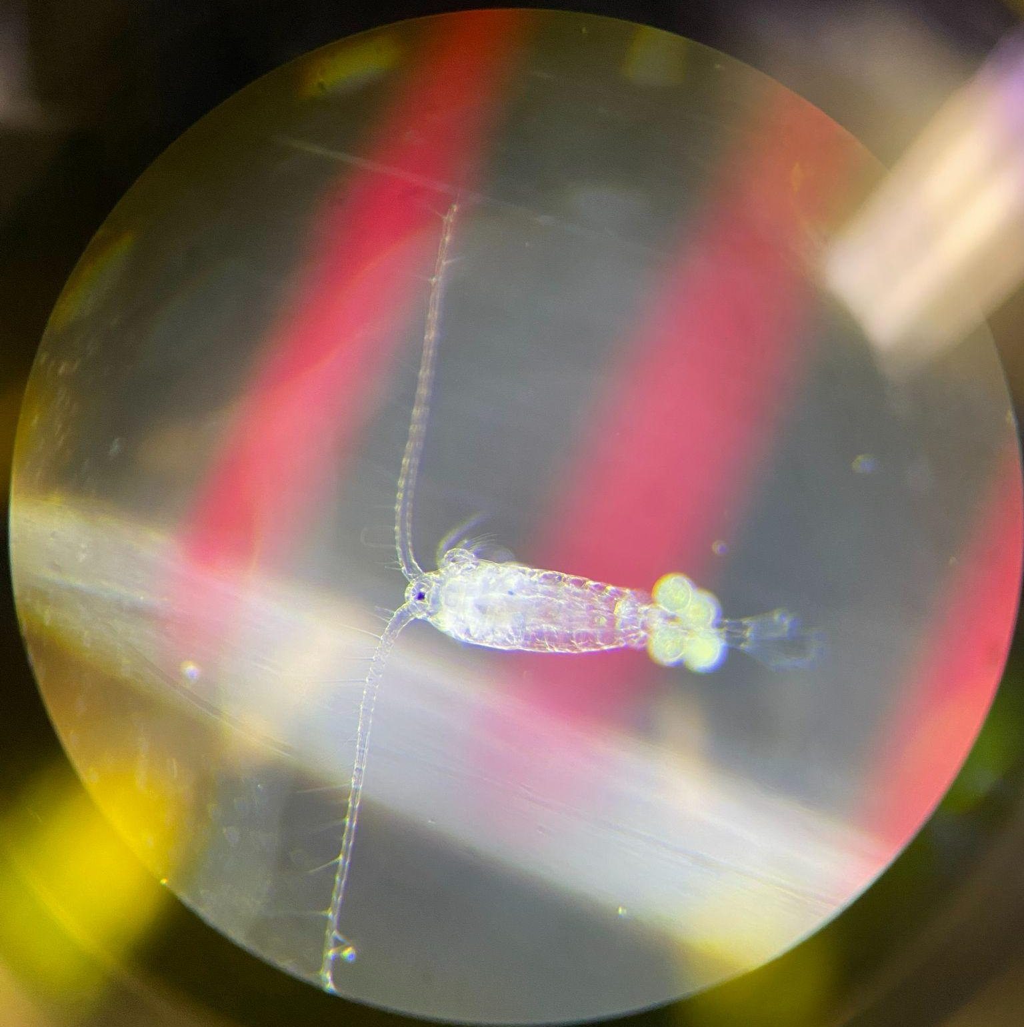

Methods - Overall Workflow
Continuous temperature data matched with time at which specific copepod hit thermal limit giving CT_{max} data
Plankton Tow
Species ID, Body size measurement, and
Fecundity

Slide 8
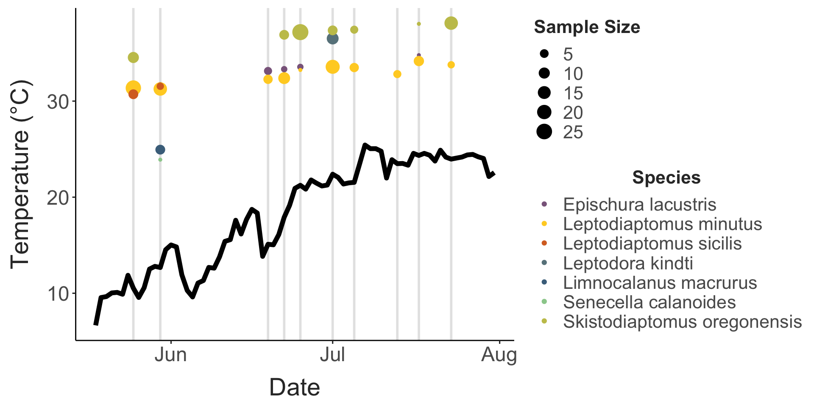
Summer temperatures from USGS data and experimental CT maxima
Notes:
-10 collections, 215 thermal limits, beginning at end of spring
-continuous temp from usgs
-points showing species thermal max, point size representing sample size
-copepod community varies seasonally
-point out three groups: low, intermediate, and high thermal limit group
-briefly mention slight difference between usgs data and what we measured in water from tows
-so far, one generation, which means that changes in thermal tolerance come from acclimation rather than adaptation
We see these changes over seasonal time scales, how well does temperature explain differences in thermal limits?

Slide 9
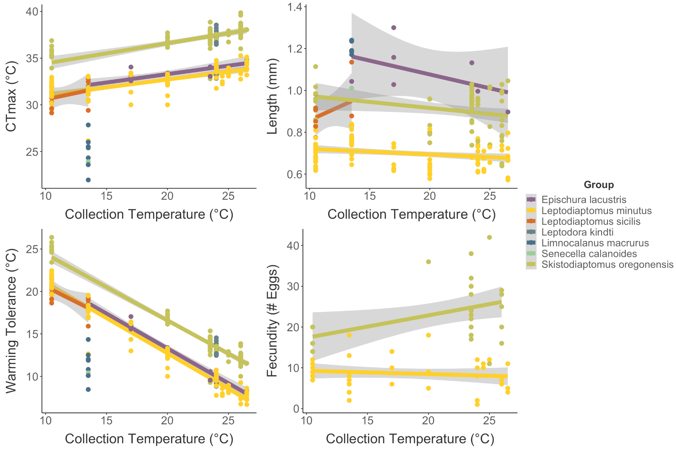

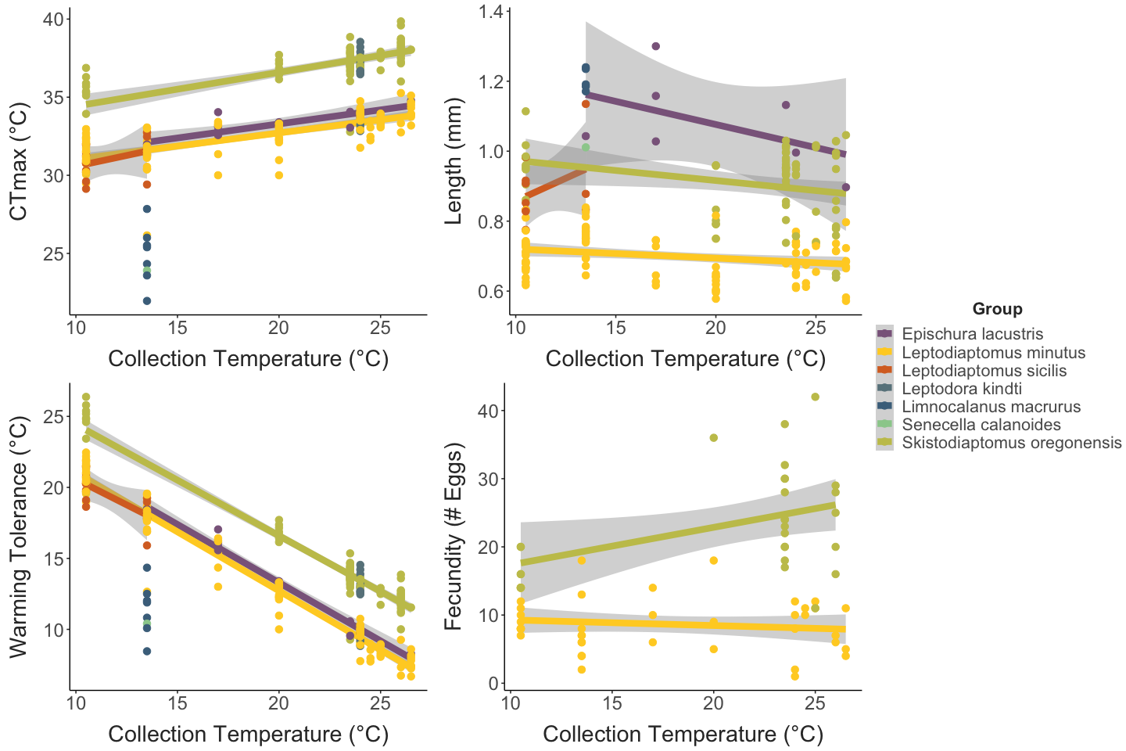
Measured collection temperature and measured thermal maxima
Notes:
As collection temp increases, so does CT max, but not by as much
Each color is species, one regression for each species

Slide 10
Measured collection temperature and calculated warming tolerance
WT = CT_{max} - Coll. Temp.
Notes:
-we can imagine these lines extending to predict the temperature at which each species would no longer be able to live in the environment
-our data suggests that skistodiaptomus is the species furthest from this point
- minutus and epischura get within 5 degrees of their thermal limits at hottest points this summer (similar to what is seen in heat waves)
Because thermal limits affect vulnerability, we want to be able to predict, looking for a trait which may be easier to measure than thermal limits themselves…investigating body size

Slide 11
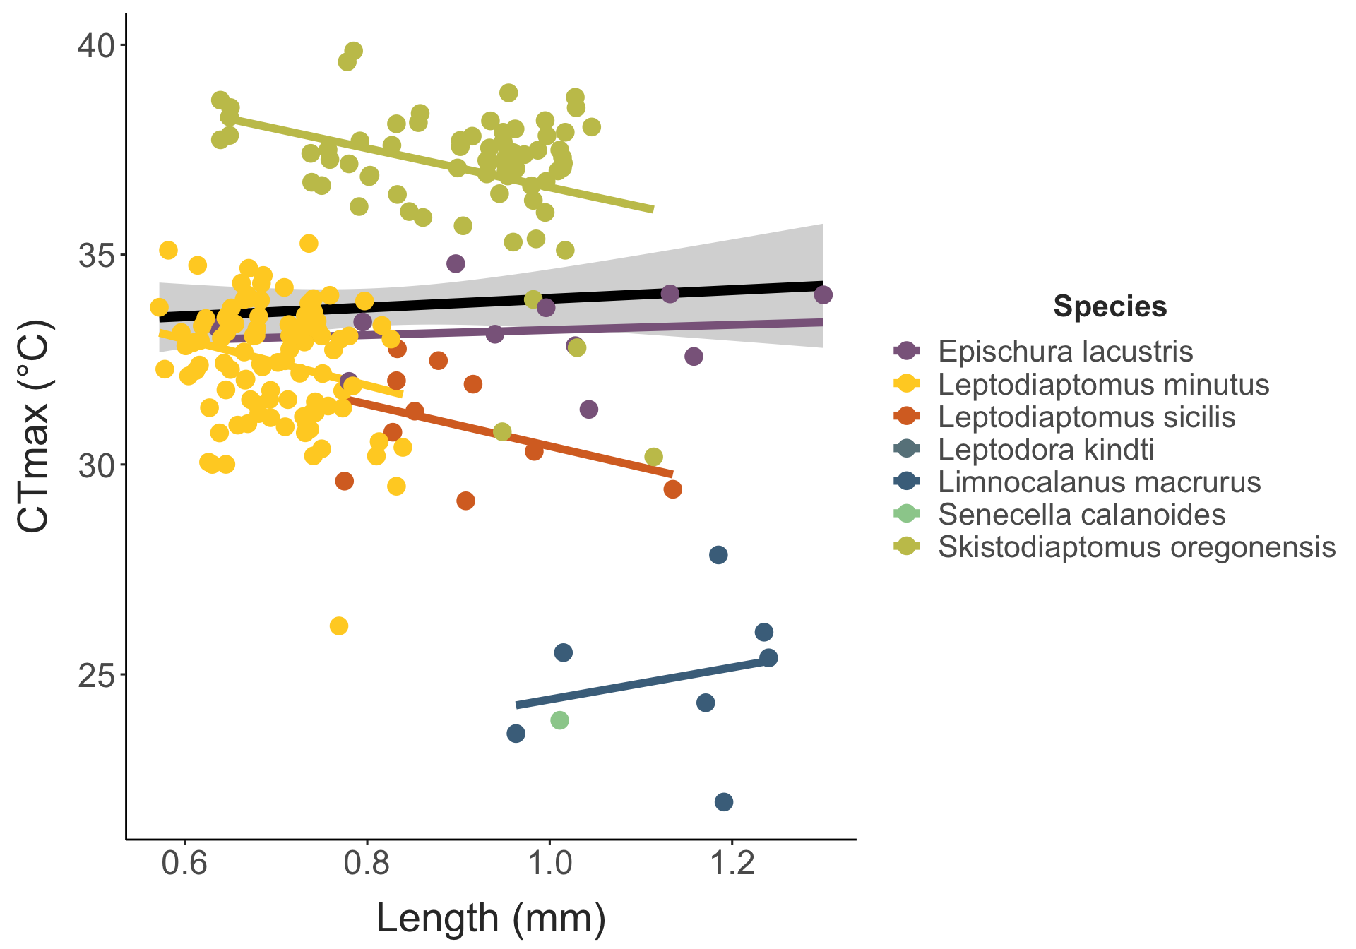
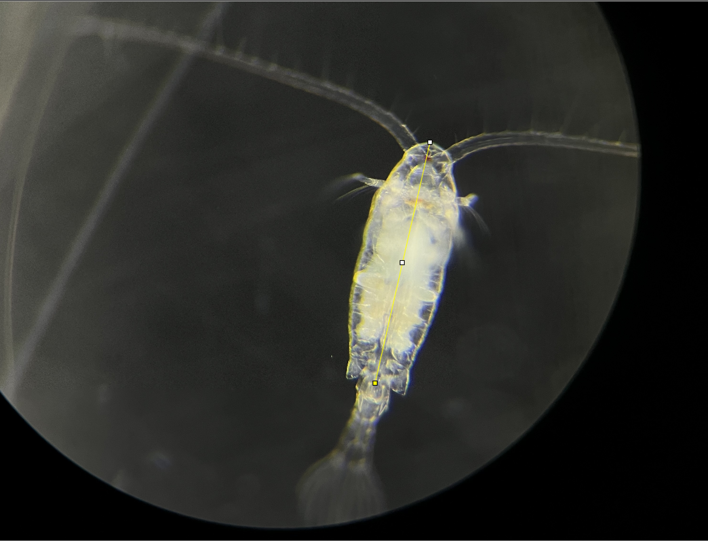
Body size (measured as prosome length) and CT_{max}
Prosome
Notes:
-universal regression in back
- no universal relationship
-within diaptomids, a relationship is starting to emerge (expected relationship based on patterns seen across phyla)
An additional measurement,

Slide 12
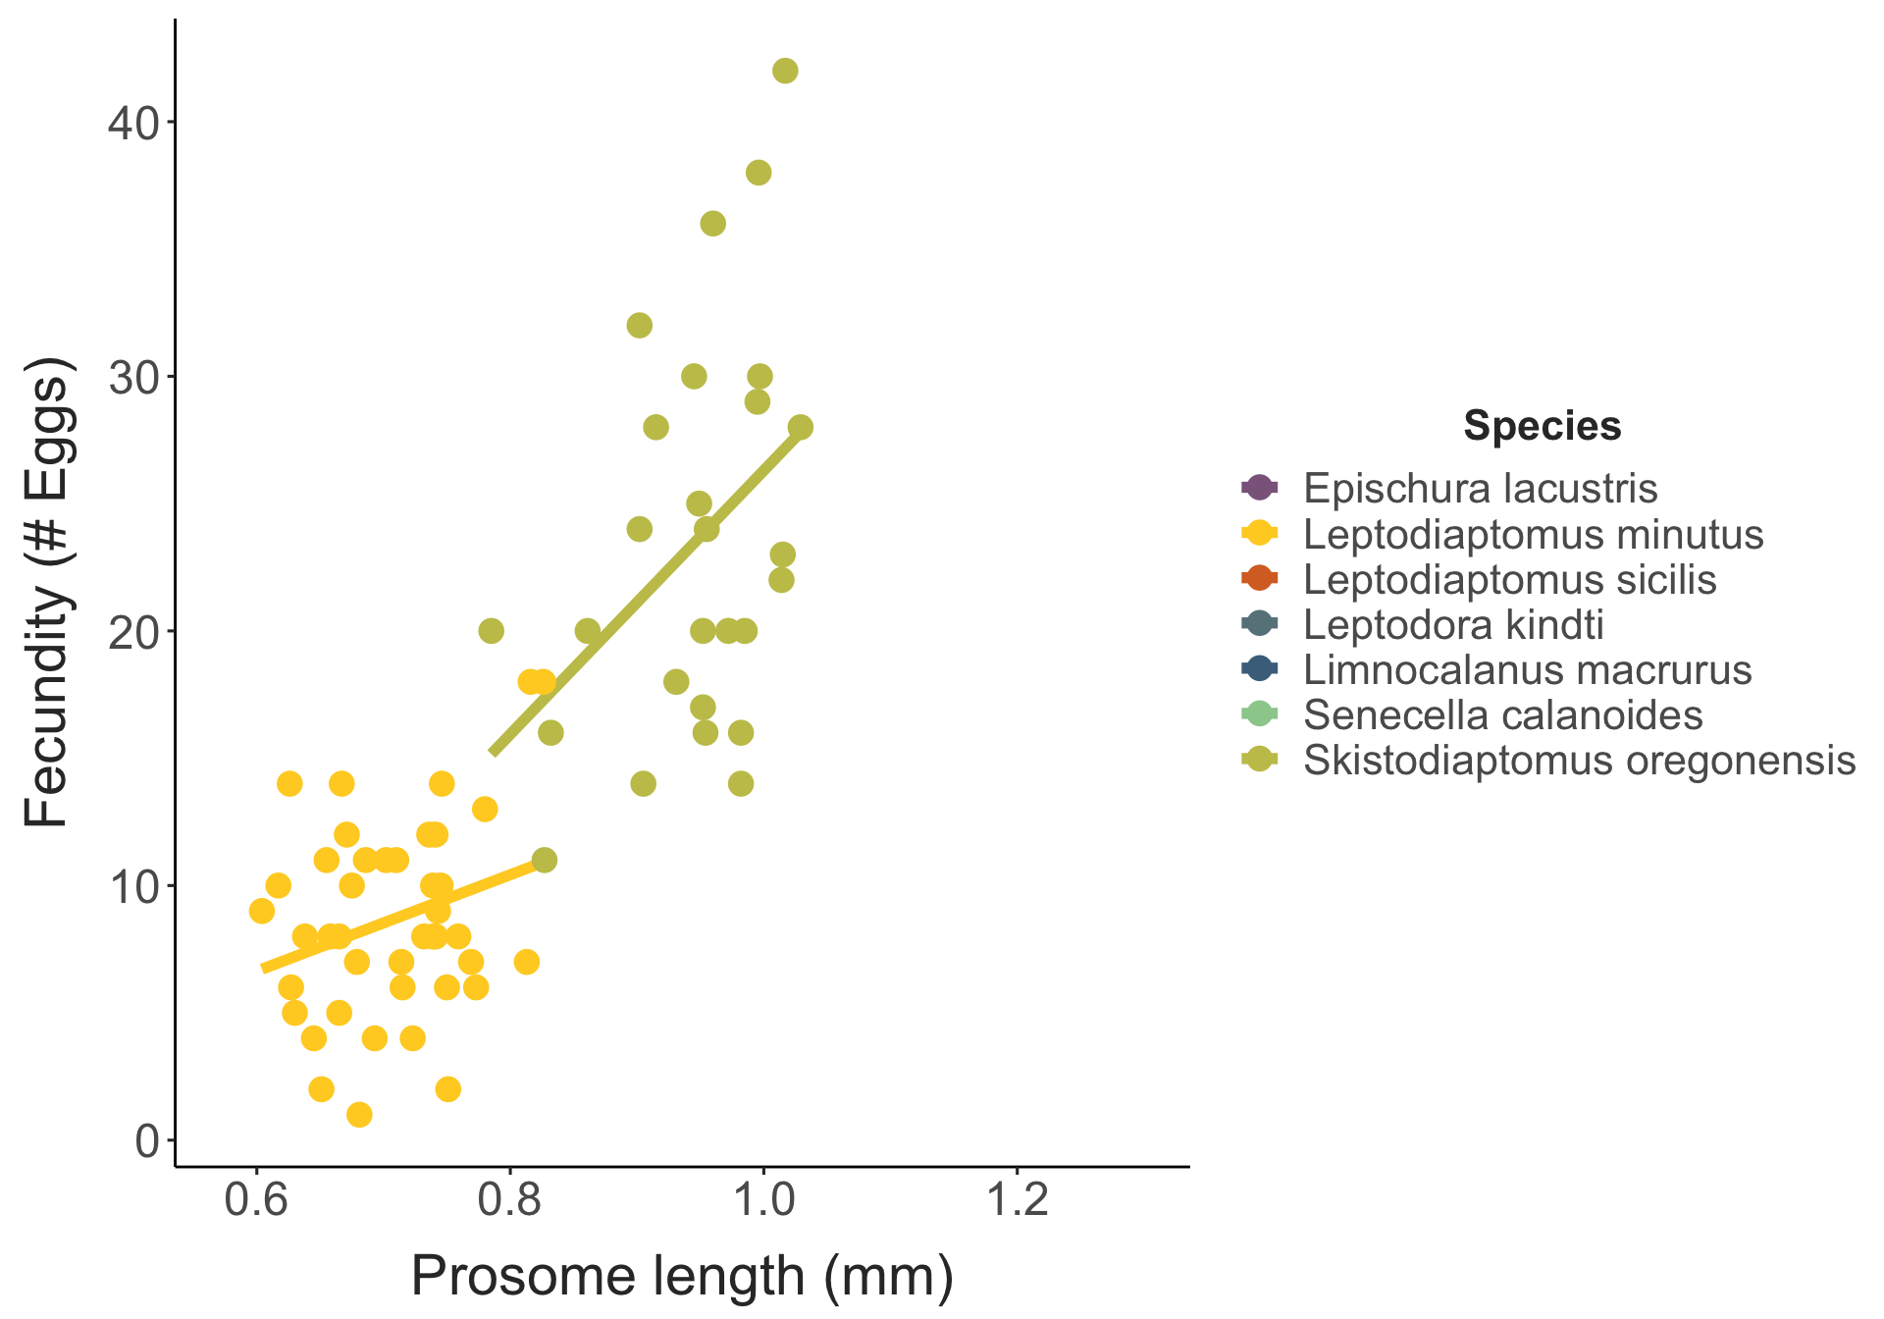
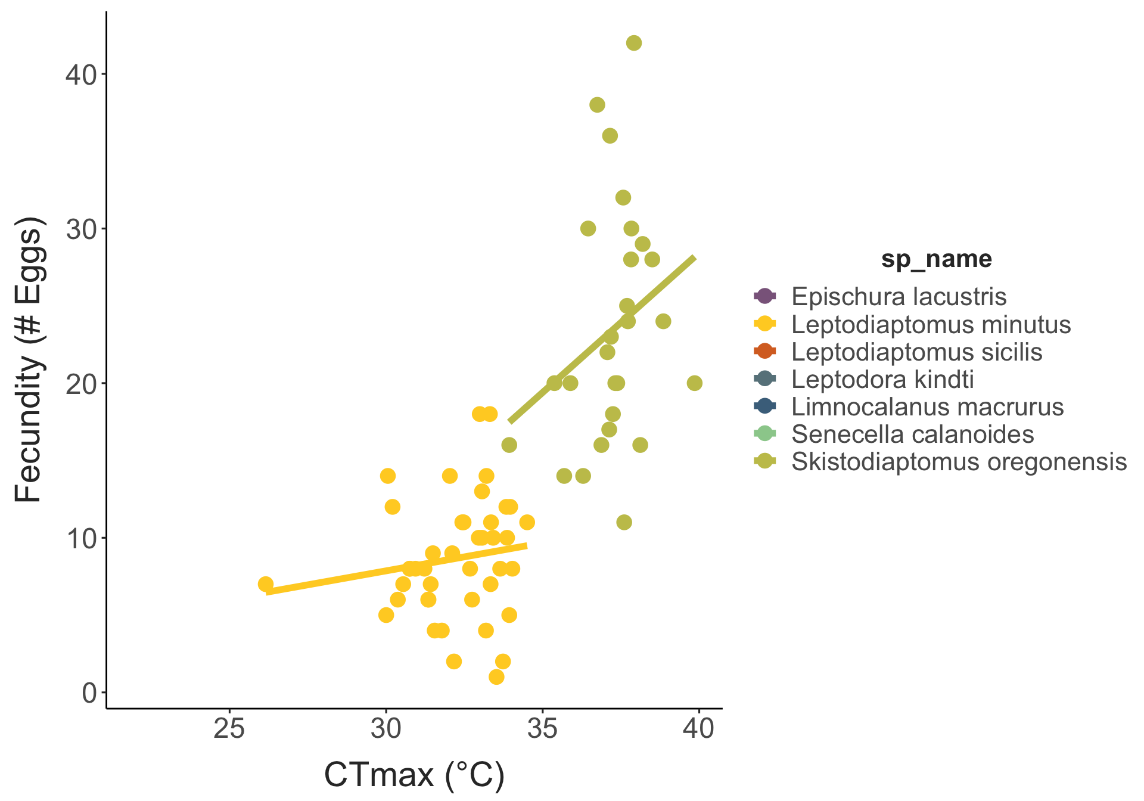
Body size and number of eggs recorded
Notes:
Fecundity vs body size
-bigger copepods produce more eggs (classic pattern)
Fecundity vs Ctmax
-no observed trade off (which we might expect based on energy allocation)
-doesn’t necessarily show higher ct max connects to higher fecundity, but definitely doesn’t show the Opposite

Slide 13
Summary
Small change in CT_{max} relative to change in lake temperatures shows limited copepod acclimation compared to other habitats
Skistodiaptomus oregonensis had a large warming tolerance but other summer species are vulnerable to extreme heat waves
Other measurements taken (body size, fecundity) showed
Relationship between body size and CT _{max} (in diaptomids)
Larger individuals produced more eggs
No trade-off between CT_{max} and egg production

Slide 14
Implications
Limited acclimation suggests that Lake Champlain copepods are vulnerable to temperature increases resulting from climate change
Species’ variation in thermal limits and warming tolerance indicates that temperature changes may cause changes in community make-up and biodiversity
If certain species “drop out” of the community, this could impact food availability for predators, control of algal growth, and carbon flux in these systems

Slide 15
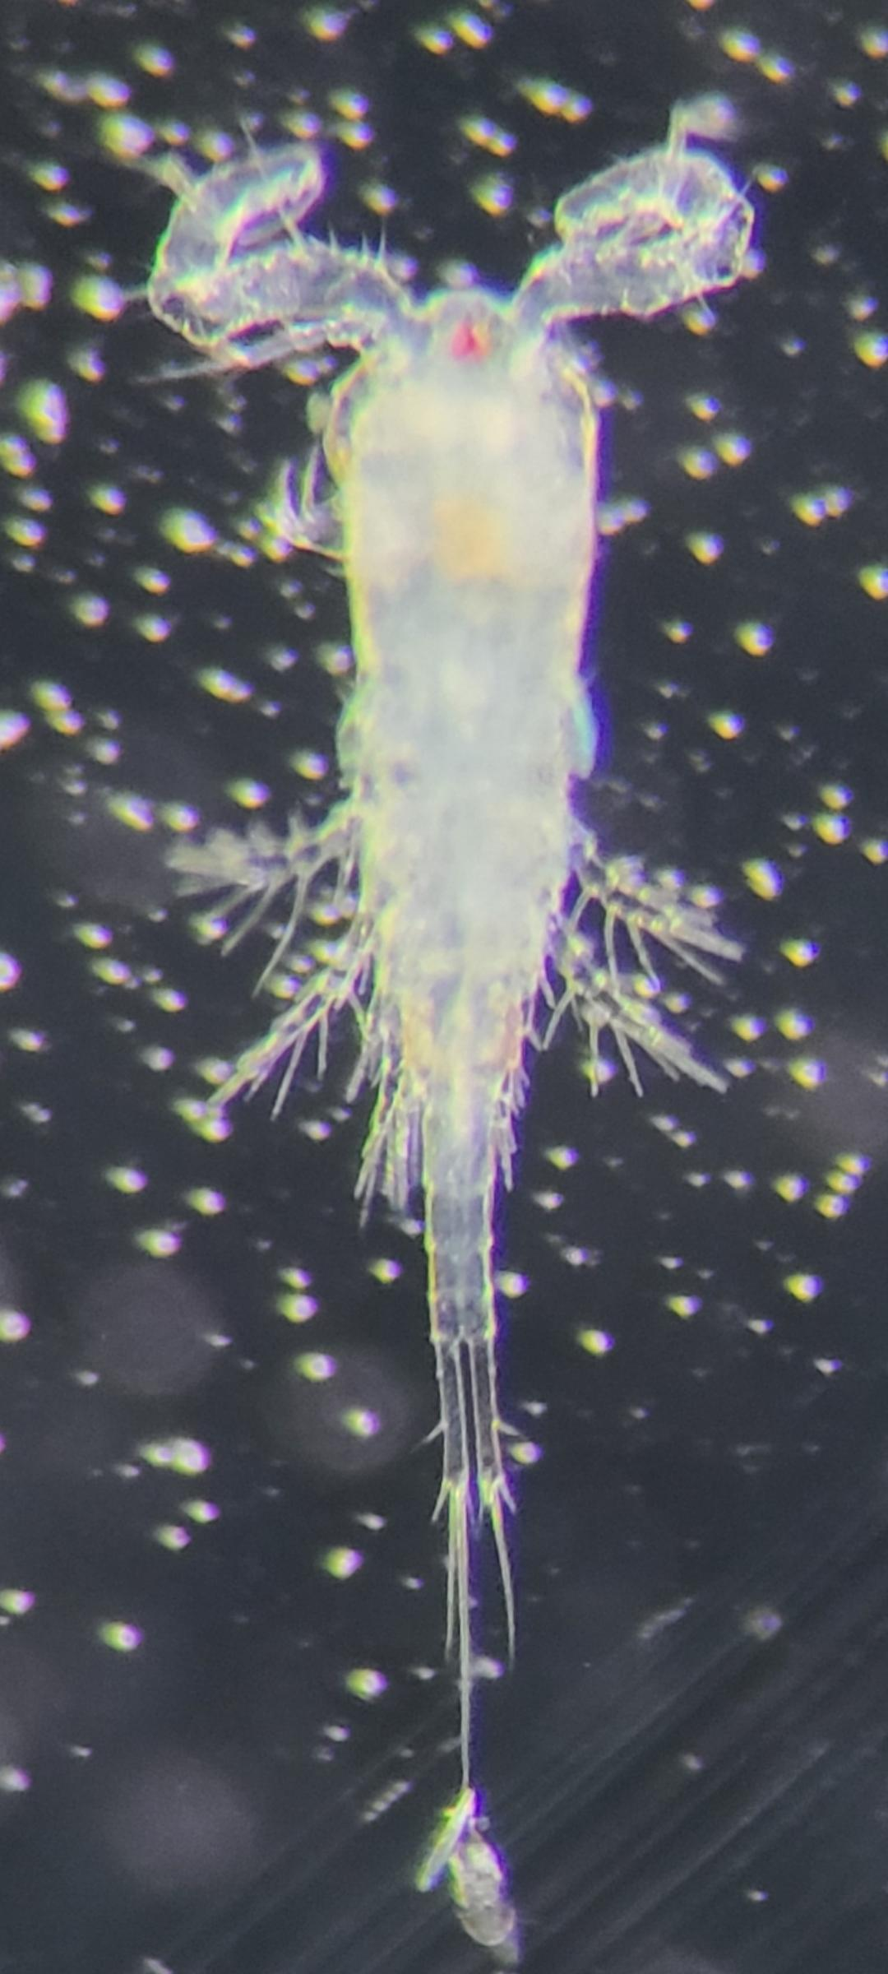
Thank you!!!

